Slide 1
Brain tumor segmentation in MRI images using nonparametric
Localization and enhancement methods with U-net
MAIDUL ISLAM (20101309)
ST : Sadiul Arefin Rafi
RA: MD Sabbir Hossain
Team : 35

Slide 2
Objectives
To propose an efficient system for the segmentation of complete brain tumors from MRI images.
To develop a novel tumor enhancement method that combines local and global information to improve the contrast and visibility of indistinct or low-contrast tumors.
To use the U-net deep learning architecture to learn features and accurately segment the trained or untrained datasets without requiring data augmentation techniques or modifying the deep learning architectures.
To evaluate the performance of the proposed system using the BRATS dataset and compare it with other state-of-the-art methods.

Slide 3
Introduction
What is a brain tumor?
What is the significance of brain tumor segmentation?
Why brain tumor segmentation is challenging?
Existing methods in Brain tumor segmentation.

Slide 4
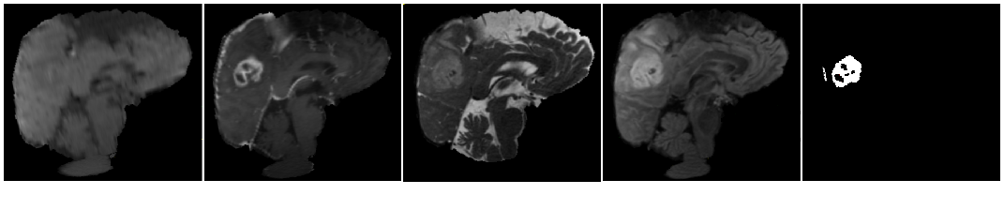
Dataset
BRATS dataset: BRATS 2012, BRATS 2019, and BRATS 2020.
Modalities: T1, T1-contrasted (T1C), T2, Fluid attenuation inversion recovery (FLAIR).
BRATS 2012: 3,725 HGG & 1,908 LGG images of 2D FLAIR.
BRATS 2019: 40,145 HGG & 11,780 LGG images of 2D FLAIR.
BRATS 2020: 57,195 images of 2D FLAIR.
Ground Truth
T1
T1c
T2
FLAIR

Slide 5
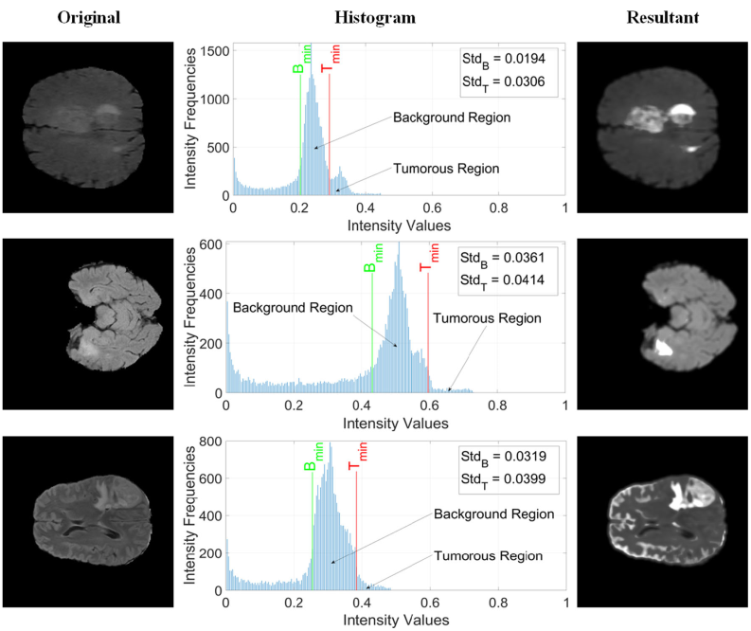
Data pre-processing
Nonparametric tumor localization.
Enhancement methods.

Slide 6
Proposed Architecture
U-net architecture.
Contracting path.
Expansive path

Slide 7

Results
Dice Score Coefficient
Achieved dice score:
BRATS 2012: 0.94
BRATS 2019: 0.85
BRATS 2020: 0.87

Slide 8
Future works

Slide 9
References
Ilhan, A., Sekeroglu, B., & Abiyev, R. (2022). Brain tumor segmentation in MRI images using nonparametric localization and enhancement methods with U-net. International journal of computer assisted radiology and surgery, 17(3), 589-600.

Slide 10
Thanks!

